Slide 1
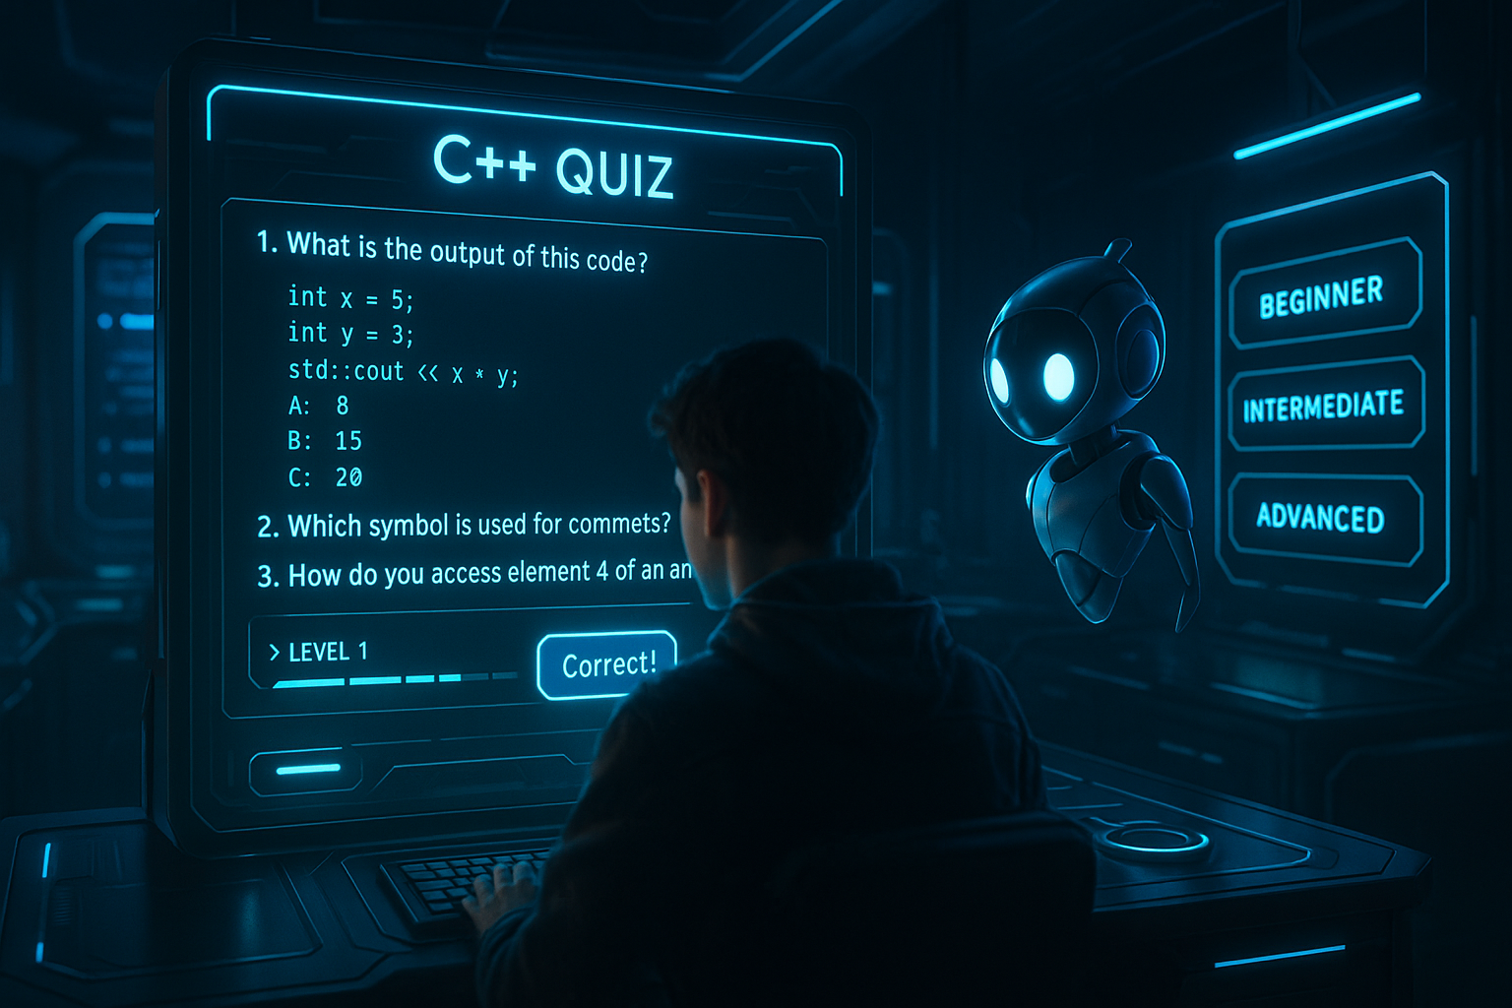
Level up++ interactive learning game

Slide 2
introduction
Welcome to LevelUP++, an innovative educational initiative aimed at enhancing the learning experience for computer science students through an engaging and interactive game-based platform. Developed using C++ programming language within the Visual Studio environment, LevelUP++ combines the power of technology with the fundamentals of computer science to provide an immersive learning environment.
LevelUP++ offers a user-friendly interface with features like Sign In and Login, Catering to learners of different proficiency levels, LevelUP++ provides three distinct options: Beginner, Intermediate, and Advanced levels.

Slide 3
Cont.…
Once you've selected your preferred level, the journey begins with a series of thought-provoking questions. Answer correctly, and you progress to the next challenge; answer incorrectly, and you're presented with the opportunity to either retake the quiz or embark on a dedicated learning path.
Join us on this educational adventure with LevelUP++, where learning meets fun, and mastery of C++ becomes an enjoyable journey!

Slide 4

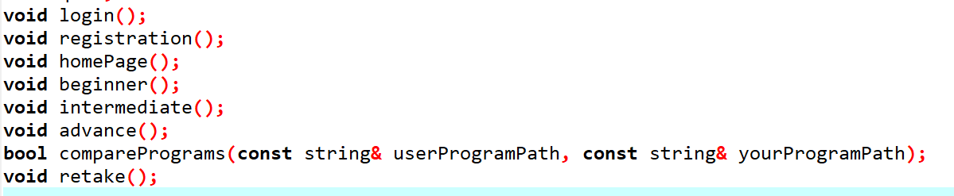


Slide 5
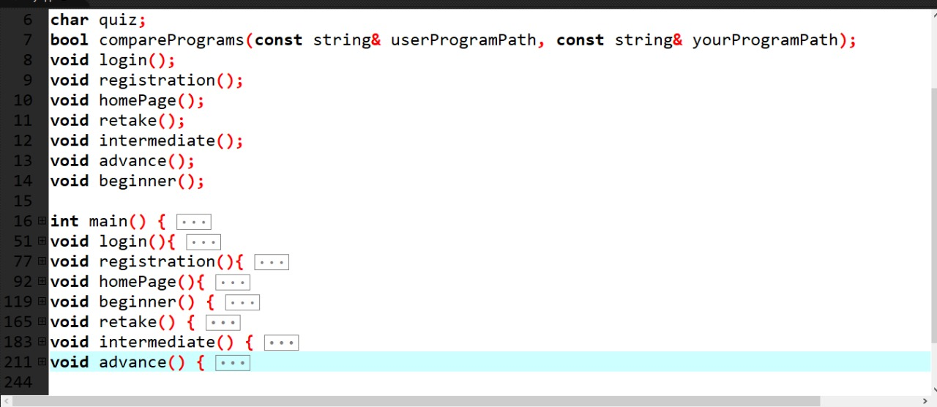
CODE!!!!

Slide 6

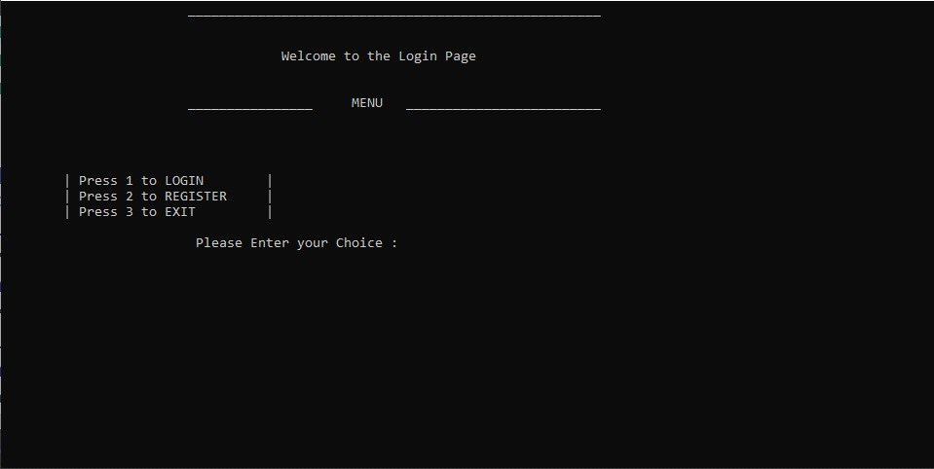
Sign IN Form

Slide 7
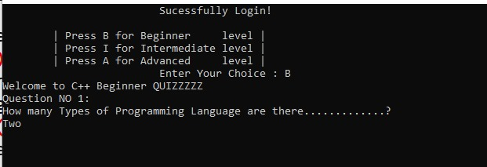
Beginner Section

Slide 8
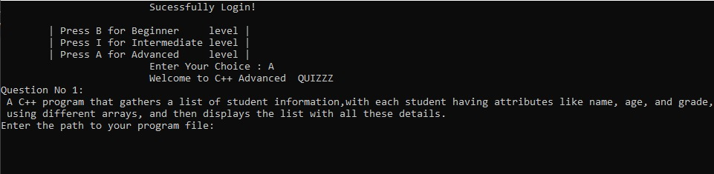
Advanced Section

Slide 9
Thank you

